Slide 1

Inventory Sales
Management Predictions
Made By: Amartya Kumar

Slide 2


Domain Of Project
Sales forecasting has always been a very significant area to concentrate upon.
Targeting the market audience is the major focus of business
sectors. It is therefore important that the company has been
able to achieve this objective by employing a system of forecasting. The process of forecasting involves analyzing
data from various sources such as market trends, consumer
behavior and other factors. This analysis would also help the
companies to manage the financial resources effectively. The
forecasting process can be used for many purposes, including: predicting the future demand of the products or service, predicting how much of the product will be sold in a
given period.

Slide 3
Problem Statement
This data set contains the information about video game sales above 100 000 copies. The data includes mostly the information about sales divided by regions.
However the information contains the data only up to 2017.
Tasks:
1.Exploration and analysis
2.Determine most successful companies, gaming genres, and platforms
lines.

Slide 4
Understanding the Data Set
Fields include
Rank - Ranking of overall sales
Name - The games name
Platform - Platform of the games release
Year - Year of the game's release
Genre - Genre of the game
Publisher - Publisher of the game
NA_Sales - Sales in North America (in millions)
EU_Sales - Sales in Europe (in millions)
JP_Sales - Sales in Japan (in millions)
Other_Sales - Sales in the rest of the world (in millions)
Global_Sales - Total worldwide sales
Data Collection
timelinhttps://www.kaggle.com/gregorut/videogamesaleses.

Slide 5
Data Preprocessing
A real-world data generally contains noises, missing values, and maybe in an unusable format which cannot be directly used for machine learning models. Data preprocessing is required tasks for cleaning the data and making it suitable for a machine learning model which also increases the accuracy and efficiency of a machine learning model.
It involves below steps:
Getting the dataset
Importing libraries
Importing datasets
Finding Missing Data
Encoding Categorical Data
Splitting dataset into training and test set
Feature scaling

Slide 6
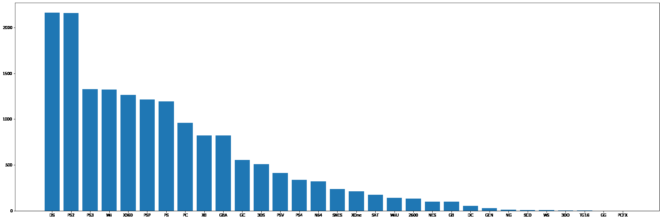
Platform which has the Highest Game

Slide 7
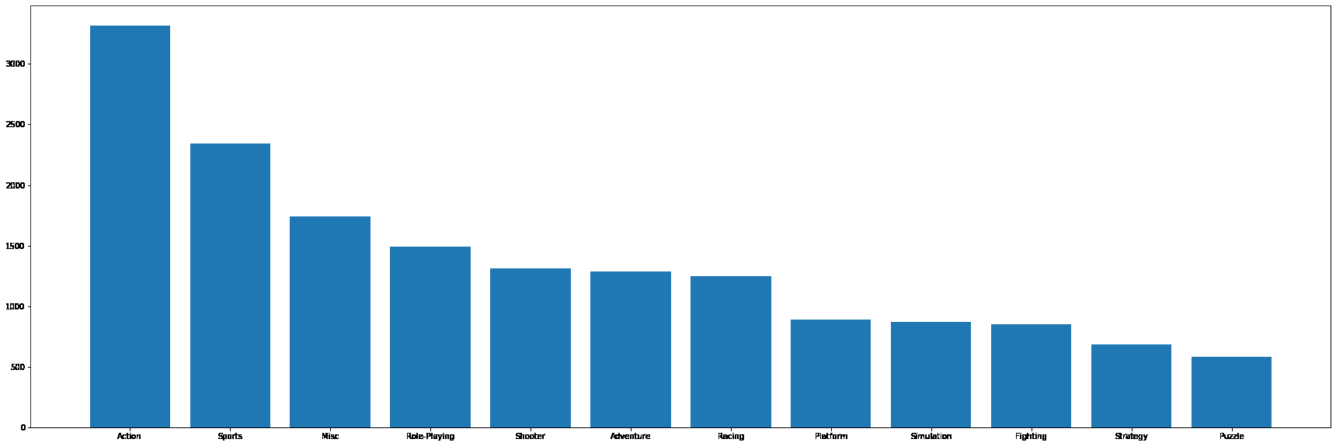
Genre Which has the Highest number of Games

Slide 8
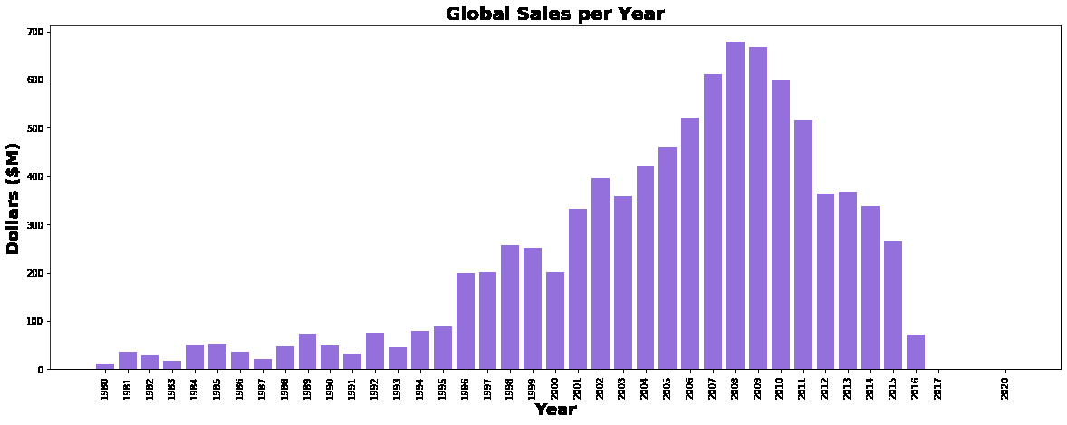

Slide 9
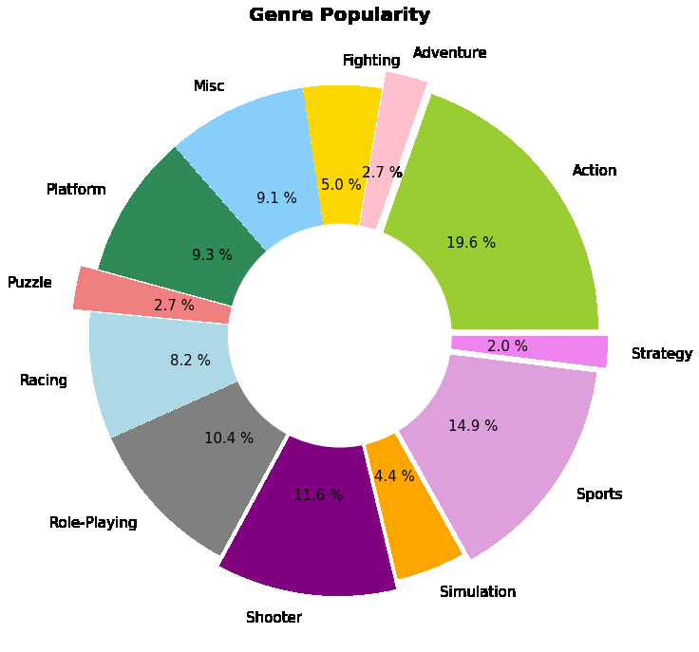

Slide 10
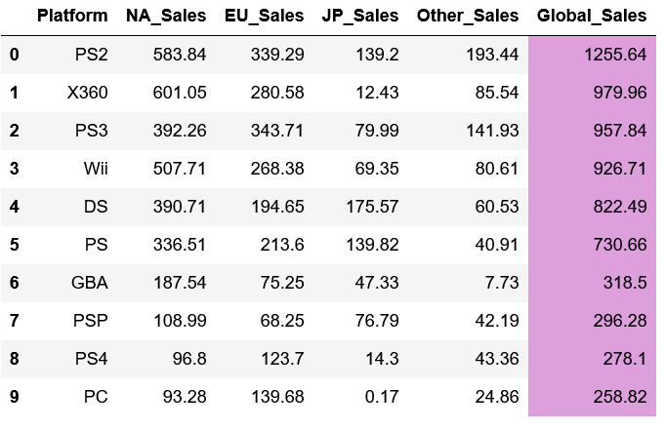
According to the data, PlayStation 2
Xbox 360
PlayStation
...... have the most successful game sales rates globally. Game consoles has been popular for a few decades because of the advantages that consoles can provide over PCs (easy to use, cost less, no need to upgrade, etc.)

Slide 11
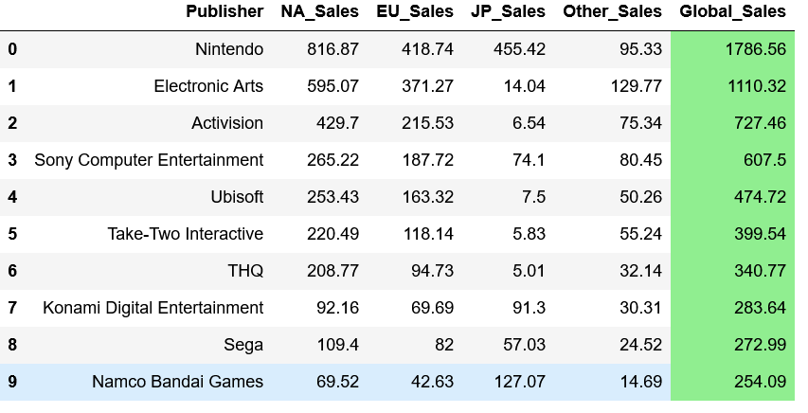
Three most successful companies Nintendo, EA, and Activision have been showing a decent level of revenue over the years.

Slide 12
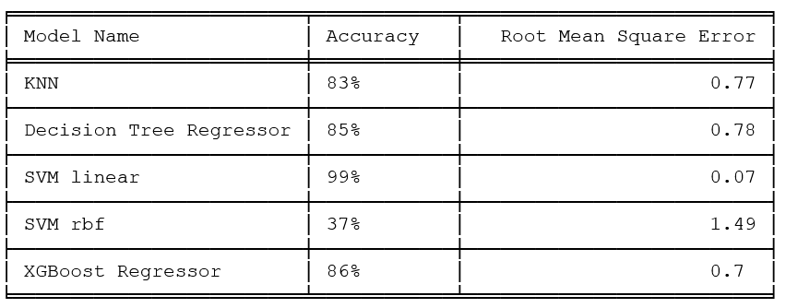
Modelling & Model Evaluation

Slide 13
Summary
1.The most profitable region - North America
2.Popular video game genres are action, sport, shooter
3.Platforms with the biggest number of video games released:
PS2, Xbox 360, PS3
4.The most successful video game publishers:
Nintendo Co. Ltd.,
Electronic Arts Inc.,
Activision Publishing,Inc.

Slide 14
THANK
YOU

